Slide 1
Health 2.0 & ISFP: Communication Toolkit Updated: March 2018

Slide 2
ISFP Communication Toolkit | Executive Summary
Using the ISFP Communication Toolkit
The Integrated Strategic and Financial Plan (ISFP) Communication Toolkit outlines the suggested approaches and sequenced steps to:
Build understanding of Health 2.0 & ISFP purpose and engagement, enthusiasm and commitment to the vision, areas of strategic focus, goals and metrics
Appropriately cascade the ISFP to senior leadership, core leaders, and front line caregivers, ensuring alignment of functional/regional strategies and tactics to the system-wide ISFP
Suggestions for using this tool:
Share this deck in gatherings with leaders and caregivers as appropriate to illustrate the long-term future of the organization and how the strategic goals will help us get there.
Use the narrative in the appendix as a guide to focus on key themes and messages.
Insert regional strategic plans and highlight local goals and metrics to connect caregivers’ work to the goals.
Use the cascade instructions in the appendix as a guide for connecting your caregivers to the ISFP

Slide 3
Presentation Slides
Presentation Slides
Putting it Together
Linking Mission, values, vision, and promise to caregiver experience and our strategy
Health 2.0
Our view of the future
ISFP
Our Integrated Strategic & Financial Plan
Caregiver Worksheet
Connecting Caregivers’ Work to the ISFP

Slide 4
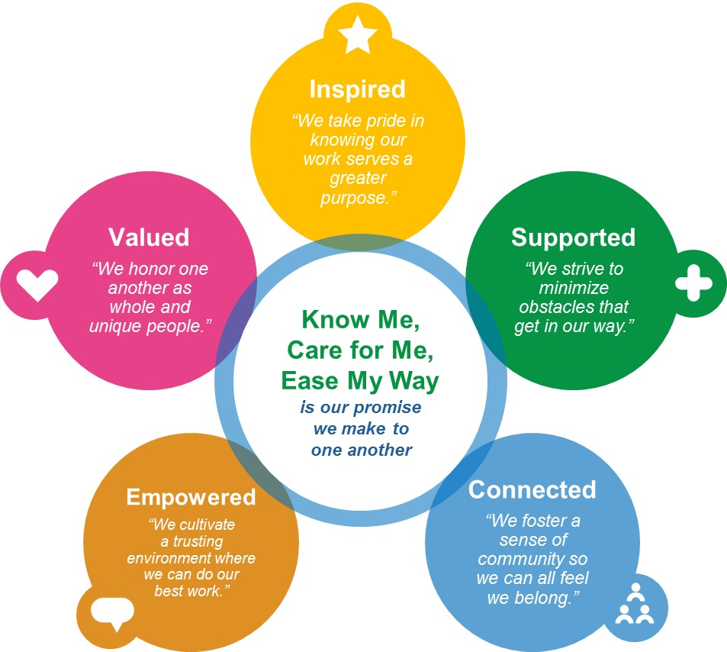
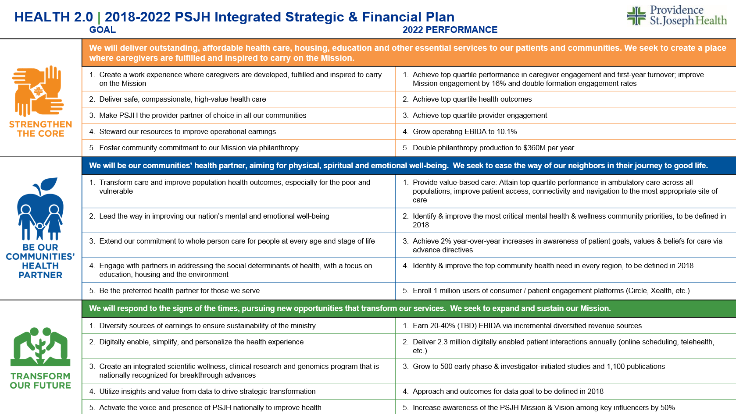
Putting it Together
Putting it Together
Mission, Values, Vision, Promise
Caregiver Experience
Strategy

Slide 5
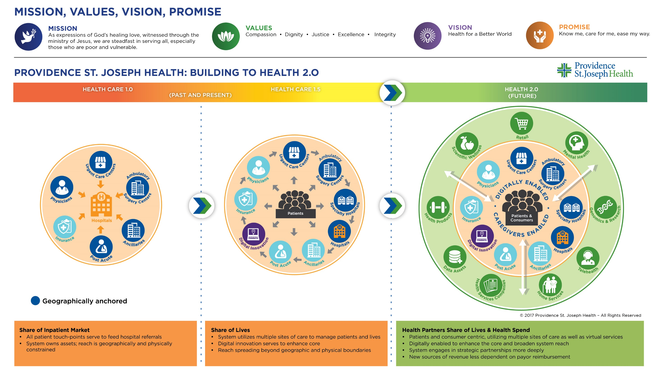

Slide 7
PSJH 2018-2022 ISFP | How you can help make Health 2.0 a reality
STRENGTHEN THE CORE
BE OUR COMMUNITIES’ HEALTH PARTNER
TRANSFORM OUR FUTURE
Create a work experience where caregivers are developed, fulfilled and inspired to carry on the Mission
Deliver safe, compassionate, high-value health care
Make PSJH the provider partner of choice in all our communities
Steward our resources to improve operational earnings
Foster community commitment to our Mission via philanthropy
Transform care and improve population health outcomes, especially for the poor and vulnerable
Lead the way in improving our nation’s mental and emotional well-being
Extend our commitment to whole person care for people at every age and stage of life
Engage with partners in addressing the social determinants of health, with a focus on education, housing and the environment
Be the preferred health partner for those we serve
Diversify sources of earnings to ensure sustainability of the ministry
Digitally enable, simplify, and personalize the health experience
Create an integrated scientific wellness, clinical research and genomics program that is nationally recognized for breakthrough advances
Utilize insights and value from data to drive strategic transformation
Activate the voice and presence of PSJH nationally to improve health
How I support this work: |  | How I support this work: |  | How I support this work:
Who else I will work with: |  | Who else I will work with: |  | Who else I will work with:

Slide 8
Appendix
Health 2.0 Narrative
This is the talk track to the Health 2.0 slides.
PSJH Mission, Values, Vision, Promise Narrative
This a brief overview of the PSJH MVVP.
ISFP Cascade Instructions
These slides explain how to cascade the ISFP with your teams.

Slide 9
Health 2.0 Narrative (page 1/5)
Health 2.0 is our roadmap. As the first Providence St. Joseph Health Integrated Strategic and Financial Plan (ISFP), it guides us in directing our efforts and resources, ensuring that while we manage the current environment, we also proactively shape our future and position the organization for long-term sustainability and transformation. Health 2.0 helps us harness the talents of 111,000 caregivers in meeting the needs of our local communities and fulfilling our Mission.
The ISFP was developed by gaining the insights of more than 1,200 local board members and foundation board members, executives, physicians and clinicians, leaders and caregivers. The resulting 2018-2022 strategic plan includes a system level plan, aligned regional level plans and aligned metrics.
Guided by Mission, we are answering the call to take a new approach and create innovative solutions to envision a new model that transforms us for the future.
Why Health 2.0?
We remain committed to advocating for and improving the health and lives of those we serve, especially the poor and vulnerable. Our new model must meet today’s many challenges such as the expanding needs and preferences of our communities, improving affordability, serving more people who rely on government-sponsored health plans, and responding to the increasing cost of labor, pharmaceuticals and supplies.

Slide 10
Health 2.0 Narrative (page 2/5)
Our focus for 2018-2022
Three strategic areas:
Strengthen the Core
Be Our Communities’ Health Partner
Transform Our Future
Health 2.0 requires a strong infrastructure to support our vision. To Strengthen the Core, we will maximize the value of our existing operations, continue to focus on our caregivers and providers, achieve excellence in clinical care, efficiency and financial results, to ensure value for those we serve. When people seek out our services, on the most important day of their lives, we need to be there and we need to be strong.
As we move beyond our traditional clinical settings, we commit to Be Our Communities’ Health Partner, providing services and collaborating with others to improve care and outcomes for the populations we serve. We will place special attention on leading the way in improving our nation’s mental health and well-being and addressing social factors that impact health. What our communities need will vary across our diverse geographies, and we will partner to respond to those unique local needs.
We will pursue goals that will Transform Our Future, including diversifying our revenue sources, ensuring financial stability, utilizing our data assets and exploring our capacity to digitally enable the health experience. We need to provide care when, where, and how our consumers and patients want to receive it. We will increase our contributions to the national health care dialogue by amplifying our voice and national presence.

Slide 11
Health 2.0 Narrative (page 3/5)
What we will achieve by 2022
By 2022, we will advance our ministry by operating the Health 2.0 model across our geographies, supported by a strong core and collaboration with our community partners. We will be the new pioneers of health care who bravely transform as we engage with and improve the lives of those we serve.
We remain confident in this lead position because, although we may need to occasionally adjust our course, we know the only direction is forward. Reimbursement increases, opaque pricing and mysterious value propositions are all in the past. Health 2.0 has promise, inspiring goals, and is at the very heart of our Mission.
Building to 2.0 Illustration
The core is significant and important in all three models.
Health Care 1.0 is the hospital centric model, largely confined to geography – 100% dependent on reimbursement.
Health Care 1.5 is designed to respond to a shifting landscape, is more patient centric, expands services and provides room to expand beyond geography. It is largely still dependent upon reimbursement.
We have ministries in both of these models.
Health 2.0 represents the transformation from a health care organization to an organization focused on health. An organization that is built around the core, but is less dependent upon the traditional financing/reimbursement mechanisms. An organization with robust revenue streams derived from health-related services, it maximizes all assets, and sees a future beyond geographic boundaries.
Health 2.0 illustrates our transformation and the significance and importance of the core.

Slide 12
Health 2.0 Narrative (page 4/5)
Health 2.0 – Goals and Performance (ISFP Slide)
This plan shows the goals and the targets for 2022, and the incremental progress we feel we can make in 2018.
Strengthen the Core
The legacy of the core is the care we extend to our communities and the services our communities depend on us to provide.
10,000 surgeries and 63,000 ED or physician visits a day. 24/7 – we are always there. The core carries the awesome responsibility to be there for the births, the deaths and the healing. The core is where we are the people we aspire to be so that those who encounter us go from us more healed, more whole, more able to live, to love, to hope and even to die.
We must continue to be committed to value and accountability, to improve our quality, safety, patient experience and make healthcare services more accessible and more affordable.
Stewardship of resources is essential, especially in improving our operational earnings in this challenging and ever-changing reimbursement environment.
Throughout our history we have depended upon the generosity of individuals and organizations. We know going forward we need to find new ways to tap into increased generosity.
Additionally, our 111,000 caregivers, the bearers of the Mission, must continue to be engaged and receive strong formation programs equipping them for leading ministry in these most challenging times.

Slide 13
Health 2.0 Narrative (page 5/5)
Becoming Our Communities’ Health Partner
Many of our population health strategies will focus on the poor, particularly those dependent upon Medicaid. We will improve care and accessibility, and move to get more control of the first dollar, to more appropriately distribute resources. The term population health does not adequately express the personal relationship we want with our communities and the people we serve. We want to be the health partner of individuals. This work involves:
Building strong relationships
Breaking down barriers
Keeping a steadfast commitment to make a difference in education, housing and mental health.
Community benefit programs must remain strong and our care for the poor and vulnerable must be optimized. We attend to the whole person and their wishes. We digitally enable our interactions to develop continuous asynchronous relationships as their health partner.
Transform Our Future
This area will stretch us the most and require meaningful changes in our investment policies and partnerships.
It will challenge us to assume new roles, create new competencies, and change structures.
We will digitize the experience and use our data to drive improvements in care, as well as eliminate and prevent disease.
We are compelled to use our voice responsibly to improve health and advocate for policy in line with our Mission.
We are blessed because we have options, we have resources and we have breadth and scale that allows us to imagine these opportunities.
With Health 2.0 we will be stronger in many ways –stronger in the care we provide, stronger in our assistance to individuals and communities and stronger with an amplified voice to protect the poor and vulnerable.

Slide 14
PSJH Mission, Values, Vision, Promise
Mission
As expressions of God’s healing love, witnessed through the ministry of Jesus, we are steadfast in serving all, especially those who are poor and vulnerable.
Values
Compassion ● Dignity ● Justice ● Excellence ● Integrity
Vision
Health for a Better World
Promise “Know me, care for me, ease my way.”
Notes:
Video Resources:
PSJH Mission and Values (running time 4:50) https://vimeo.com/260845722
PSJH Vision and Promise (running time 4:59) https://vimeo.com/261036622
It’s a New Day 2018 (running time 2:56) https://vimeo.com/260845665
New Mission Statement and Values
New Vision Statement and Promise Statement
It’s a New Day-2018

Slide 15
PSJH Mission, Values, Vision, Promise Narrative
Looking to the future
Every day, 111,000+ compassionate caregivers serve patients and communities across seven states through Providence St. Joseph Health, a national, Catholic, not-for profit health system. Our ministry is a diverse family of organizations united by a belief that health is a human right. Rooted in the founding missions of the Sisters of Providence and the Sisters of St. Joseph of Orange, we share a singular commitment to improve the health of all, especially the poor and vulnerable.
Providence St. Joseph Health is boldly imagining the best health model for the future – today. We are inspired and guided by our new statements of Mission, values, vision and promise.
Mission and values are central to who we are and how we do the work of providing services and accessible, high-quality compassionate care in an increasingly uncertain world – regardless of coverage or ability to pay. The vision sets the course for our aspirations and unites and attracts the like-minded. Our promise keeps us focused and reminds us what matters most.
Providence St. Joseph Health and its Catholic and faith-based ministries will adopt the Mission statement, new values, vision and promise. Our other than Catholic partners will continue to use their current mission and values. The vision and promise will go through an adoption process by each board.
You are invited to reflect on these words that give shape to our future. Consider how you are called to this ministry and how you will bring your gifts and humanity to wherever you serve.

Slide 16
ISFP Cascade Instructions (page 1/2)
ISFP Cascade Instructions (page 1/2)
The following slides can be used as a guide to cascade the ISFP to your next level leadership, as well as involve them in connecting their function and team’s work to the ISFP
1
Set aside 45-60 min with your leadership team to complete the cascading exercise
Using the Health 2.0 Narrative (slides 9-13), share the ISFP with your next level leadership team. The Health 2.0 graphic and ISFP are on slides 5-6 for quick reference
2
Use the worksheet on slide 7 to document, individually and then together as a team, how you will support the ISFP, and who else / what other functions you will need to work with to successfully implement your strategies and tactics
3
4
Utilizing the suggestions on slide 15, build follow-up into your function’s ongoing systems and structures
5
Instruct your leadership team to follow same process with their teams and so on

Slide 17
ISFP Cascade Instructions (page 2/2)
Now that you’ve shared the ISFP with your leadership team, here’s what you can do next to help ensure we achieve our PSJH goals and strategies:
Build an annual department/team workplan to achieve the strategies you identified with key milestones for achievement
Use the priorities/programs you identified and tie these to core leader and team performance goals
Share the ISFP and identified functional/team tactics with all of your caregivers, gather feedback from and inspire them to align tactics/individual actions
Regularly review priority/program progress on a monthly basis during your team/leadership meetings
Review performance against goals utilizing the PSJH System Dashboard
Review ISFP on quarterly basis with your team, continue to ensure alignment of work to ISFP

Slide 18
Questions?
For ISFP communication planning questions, please contact:
Darrin Godin, executive director, organizational communication
For ISFP cascading questions, please contact:
Kristina Hansen Smith, group vice president, strategic services
For Mission and values questions, please contact:
Your regional communication or mission leaders

Slide 19
Appendix 2
Includes versions of Health 2.0, ISFP, and caregiver worksheet without the PSJH Mission, values, vision, promise statements and versions with just the vision and promise for areas of the organization that are not adopting some or all of the common statements.

Slide 20
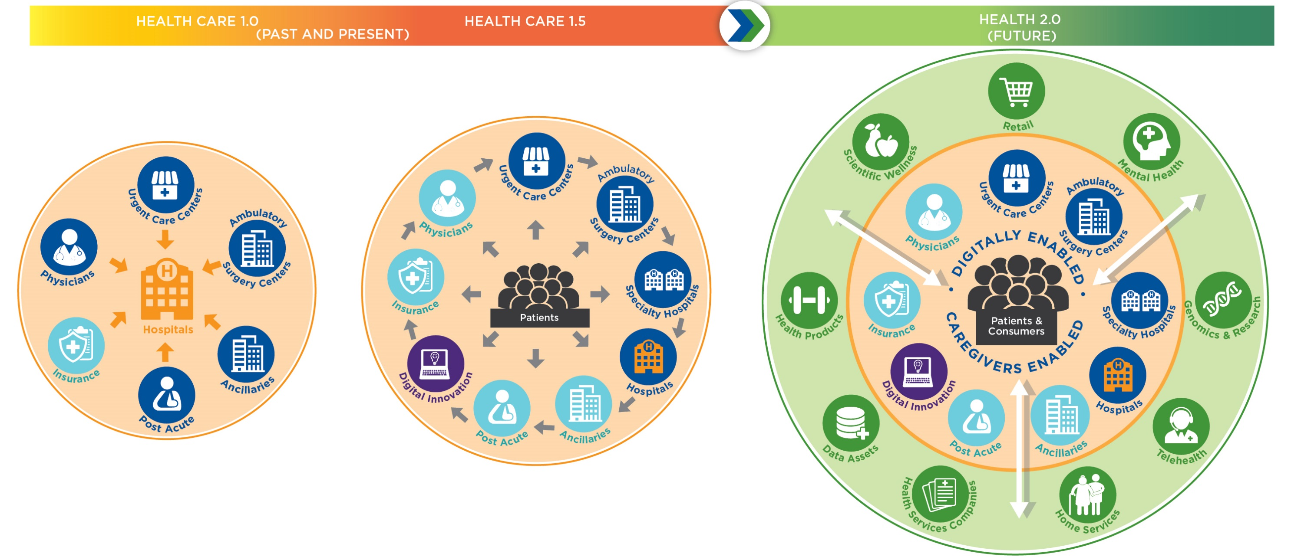
Providence St. Joseph Health: Building to Health 2.0
© 2017 Providence St. Joseph Health – All Rights Reserved
Share of Inpatient Market
All patient touch-points serve to feed hospital referrals
System owns assets; reach is geographically and physically constrained
Share of Lives
System utilizes multiple sites of care to manage patients and lives
Digital innovation serves to enhance core
Reach spreading beyond geographic and physical boundaries
Health Partners Share of Lives & Health Spend
Patients and consumer centric, utilizing multiple sites of care as well as virtual services
Digitally enabled to enhance the core and broaden system reach
System engages in strategic partnerships more deeply
New sources of revenue less dependent on payor reimbursement
20
Notes:
This version is for organizations that are not adopting the PSJH Mission, values, vision or promise.

Slide 21
HEALTH 2.0 | 2018-2022 PSJH Integrated Strategic & Financial Plan
 | GOAL | 2022 PERFORMANCE
 | We will deliver outstanding, affordable health care, housing, education and other essential services to our patients and communities. We seek to create a place where caregivers are fulfilled and inspired to carry on the Mission.
 | Create a work experience where caregivers are developed, fulfilled and inspired to carry on the Mission | Achieve top quartile performance in caregiver engagement and first-year turnover; improve Mission engagement by 16% and double formation engagement rates
 | Deliver safe, compassionate, high-value health care | Achieve top quartile health outcomes
 | Make PSJH the provider partner of choice in all our communities | Achieve top quartile provider engagement
 | Steward our resources to improve operational earnings | Grow operating EBIDA to 10.1%
 | Foster community commitment to our Mission via philanthropy | Double philanthropy production to $360M per year
 | We will be our communities’ health partner, aiming for physical, spiritual and emotional well-being. We seek to ease the way of our neighbors in their journey to good life.
 | Transform care and improve population health outcomes, especially for the poor and vulnerable | Provide value-based care: Attain top quartile performance in ambulatory care across all populations; improve patient access, connectivity and navigation to the most appropriate site of care
 | Lead the way in improving our nation’s mental and emotional well-being | Identify & improve the most critical mental health & wellness community priorities, to be defined in 2018
 | Extend our commitment to whole person care for people at every age and stage of life | Achieve 2% year-over-year increases in awareness of patient goals, values & beliefs for care via advance directives
 | Engage with partners in addressing the social determinants of health, with a focus on education, housing and the environment | Identify & improve the top community health need in every region, to be defined in 2018
 | Be the preferred health partner for those we serve | Enroll 1 million users of consumer / patient engagement platforms (Circle, Xealth, etc.)
 | We will respond to the signs of the times, pursuing new opportunities that transform our services. We seek to expand and sustain our Mission.
 | Diversify sources of earnings to ensure sustainability of the ministry | Earn 20-40% (TBD) EBIDA via incremental diversified revenue sources
 | Digitally enable, simplify, and personalize the health experience | Deliver 2.3 million digitally enabled patient interactions annually (online scheduling, telehealth, etc.)
 | Create an integrated scientific wellness, clinical research and genomics program that is nationally recognized for breakthrough advances | Grow to 500 early phase & investigator-initiated studies and 1,100 publications
 | Utilize insights and value from data to drive strategic transformation | Approach and outcomes for data goal to be defined in 2018
 | Activate the voice and presence of PSJH nationally to improve health | Increase awareness of the PSJH Mission & Vision among key influencers by 50%
© 2017 Providence St. Joseph Health – All Rights Reserved
Notes:
This version is for organizations that are not adopting the PSJH Mission, values, vision or promise.

Slide 22
Enter mission here.
Enter values here.
Notes:
This version allows customization for organizations that are maintaining their own mission and values.

Slide 23
Enter mission here.
Enter values here.
Notes:
This version allows customization for organizations that are maintaining their own mission and values.

Slide 24
Enter mission here.
Enter values here.
PSJH 2018-2022 ISFP | How you can help make Health 2.0 a reality
STRENGTHEN THE CORE
BE OUR COMMUNITIES’ HEALTH PARTNER
TRANSFORM OUR FUTURE
Create a work experience where caregivers are developed, fulfilled and inspired to carry on the Mission
Deliver safe, compassionate, high-value health care
Make PSJH the provider partner of choice in all our communities
Steward our resources to improve operational earnings
Foster community commitment to our Mission via philanthropy
Transform care and improve population health outcomes, especially for the poor and vulnerable
Lead the way in improving our nation’s mental and emotional well-being
Extend our commitment to whole person care for people at every age and stage of life
Engage with partners in addressing the social determinants of health, with a focus on education, housing and the environment
Be the preferred health partner for those we serve
Diversify sources of earnings to ensure sustainability of the ministry
Digitally enable, simplify, and personalize the health experience
Create an integrated scientific wellness, clinical research and genomics program that is nationally recognized for breakthrough advances
Utilize insights and value from data to drive strategic transformation
Activate the voice and presence of PSJH nationally to improve health
How I support this work: |  | How I support this work: |  | How I support this work:
Who else I will work with: |  | Who else I will work with: |  | Who else I will work with:
Notes:
This version allows customization for organizations that are maintaining their own mission and values.

