Slide 1
VAV Tool
12/8/2020

Slide 2
Login Page

Slide 3
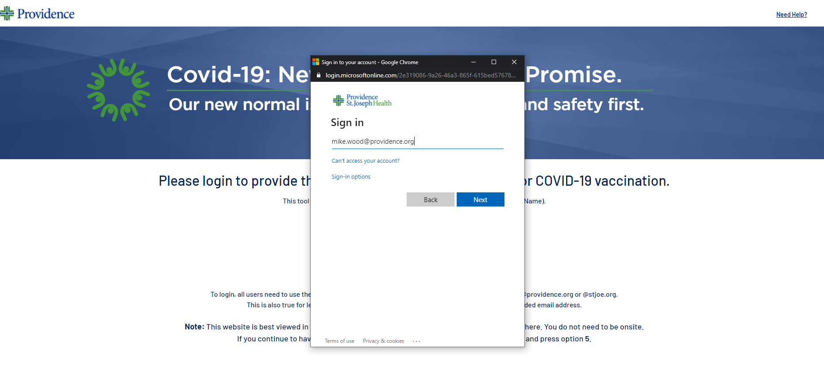
Modern Network ID (UPN) Entry

Slide 4
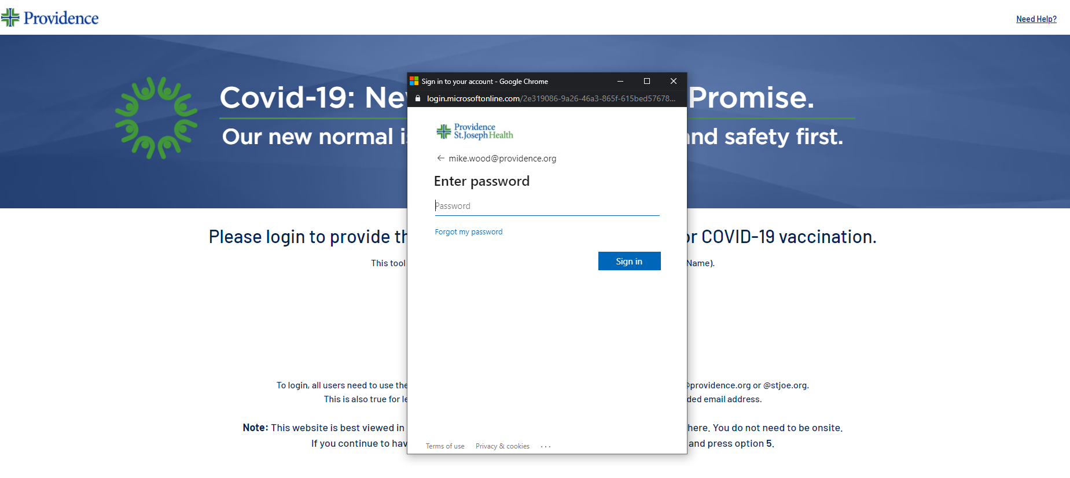
Password Entry

Slide 5
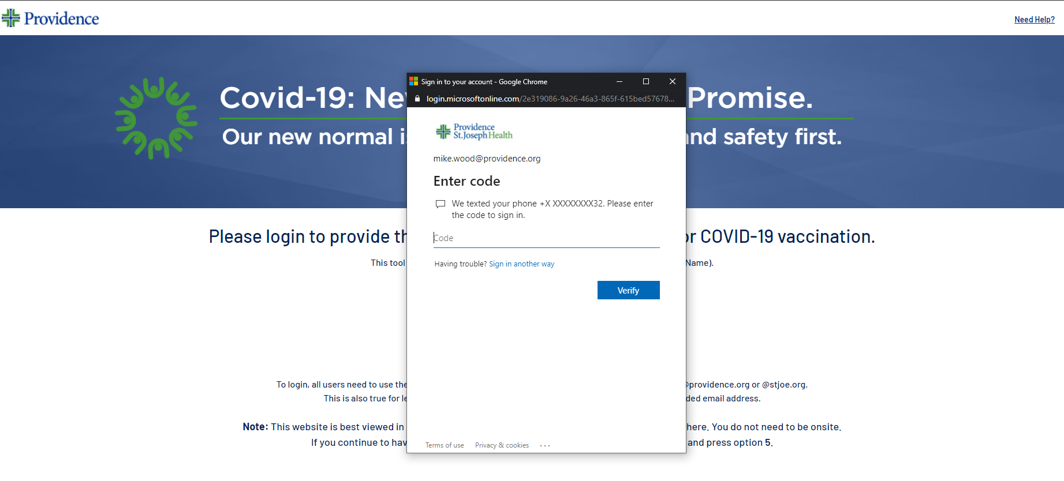
Multi-Factor Authentication

Slide 6
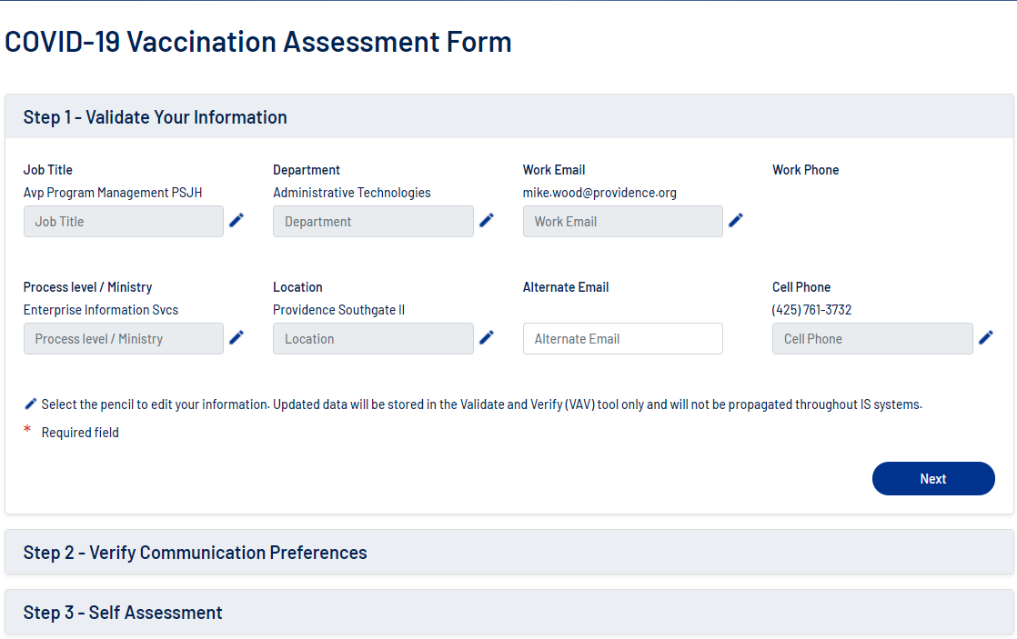
Step 1 – Validate Your Information

Slide 7
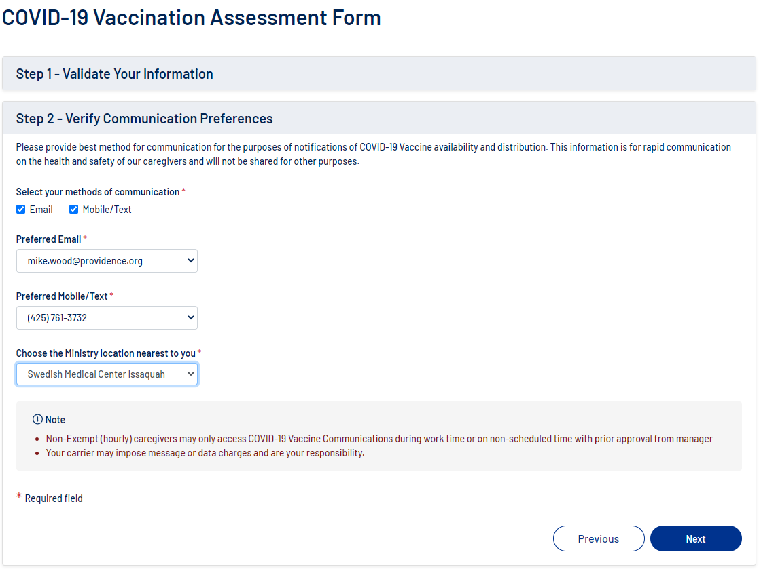
Step 2 – Verify Communication Preferences

Slide 8
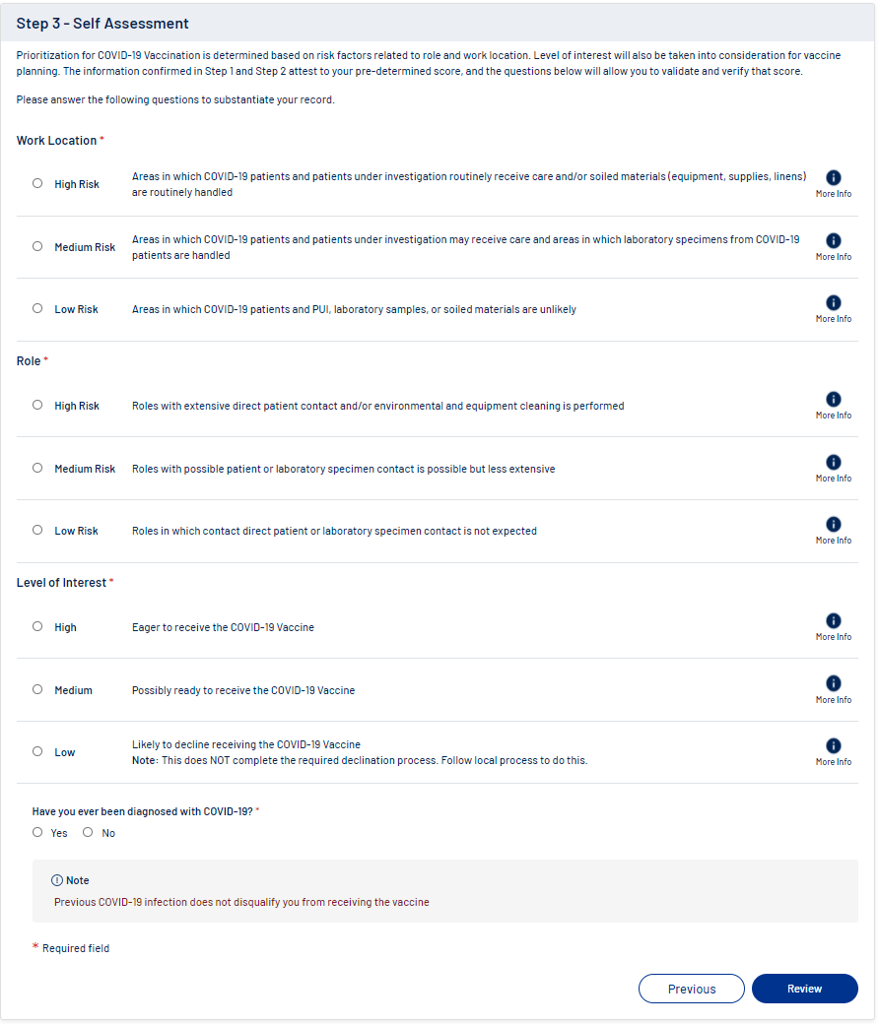
Step – 3 Self Assessment

Slide 9
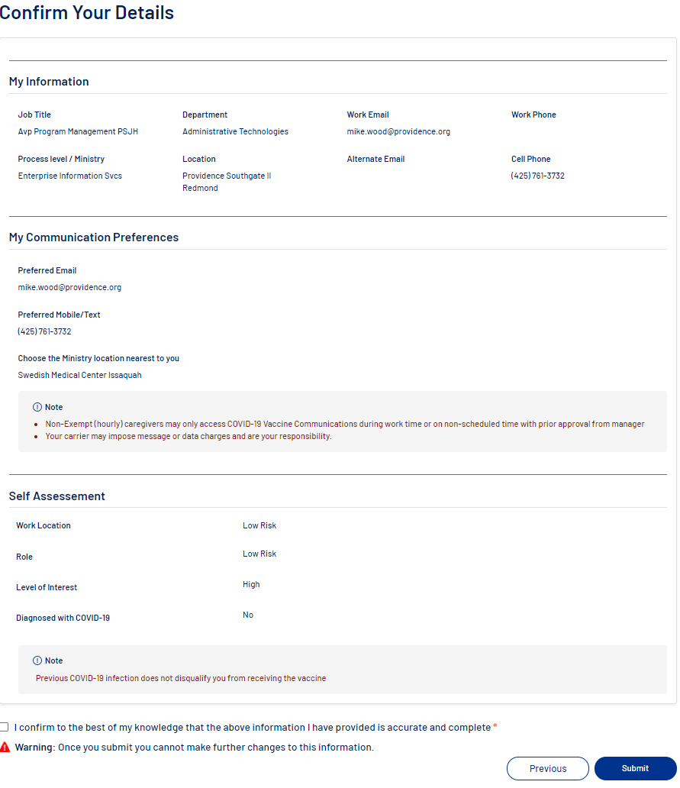
Confirm Your Details

Slide 10
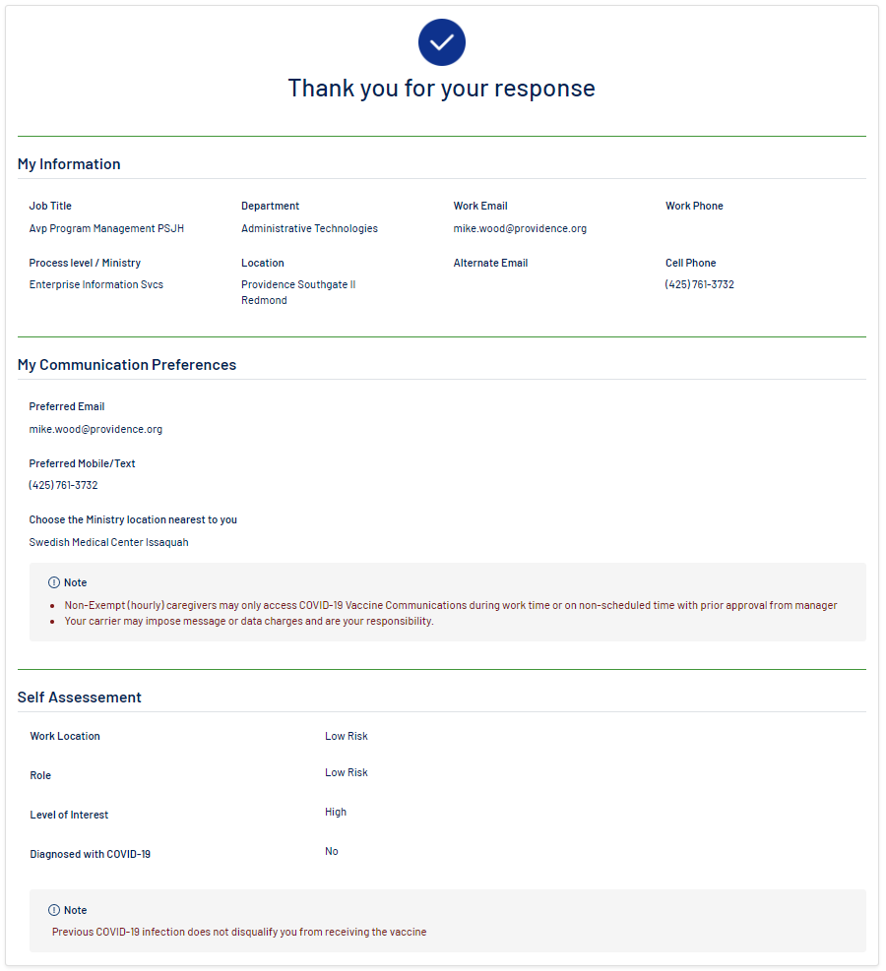
Thank you for your response

